Slide 1

Department of CSE-H
AI for Data Science
21CS2213RA/AA/PA
Topic:
LOCAL SEARCH ALGORITHMS
Session - 7

Slide 2



AIM OF THE SESSION
To familiarize students with the basic concept of Local Search
INSTRUCTIONAL OBJECTIVES
This Session is designed to:
Explain the local search algorithms
Describe simulated annealing and beam search
LEARNING OUTCOMES
At the end of this session, you should be able to:
Define the concept of Local Search algorithms
Understand about simulated annealing and beam search

Slide 3
SESSION INTRODUCTION
This session provides the basics of local search algorithms.
This session also gives an idea about simulated annealing and local beam search

Slide 4
This systematicity is achieved by keeping one or more paths in memory and by recording which alternatives have been explored at each paint along the path.
When a goal is found, the path to that goal also constitutes a solution to the problem.
In many problems, how-ever, the path to the goal is irrelevant. For example, in the 8-queens problem . what matters is the final configuration of queens, not the order in which they are added.
The same general property holds for many important applications such as integrated-circuit de-sign, factory-flour layout, job-shop scheduling, automatic programming, telecommunications network optimization, vehicle routing. and portfolio management.

Slide 5
LOCAL SEARCH ALGORITHMS
Local search algorithms operate using a single current node (rather than multiple paths) and generally move only to neighbors of that node.
Typically, the paths followed by the search are not retained.
Although local search algorithms are not systematic, they have two key advantages:
they use very little memory—usually a constant amount; and
they can often find reasonable solutions in large or infinite(continuous) state spaces for which systematic algorithms are unsuitable.

Slide 6
In addition to finding goals, local search algorithms are useful for solving pure optimization problems, in which the aim is to find the best state according to an objective function.
A complete local search algorithm always finds a goal if one exists;
An optimal algorithm always finds a global minimum/maximum.

Slide 7
HILL CLIMIBING
Hill climbing is a simple local optimization method that “climbs” up the hill until a local optimum is found (assuming a maximization goal).
The method works by iteratively searching for new solutions within the neighborhood of current solution, adopting new solutions if they are better.
There are several hill climbing variants
Steepest Ascent Hill Climbing: which searches for upto N solutions in the neighborhood of S and then adops the best one. It is time consuming but gives an optimum result.
Stochastic Hill Climbing: which replaces the deterministic select function, selecting new solution with a probability of P.

Slide 8
Hill Climbing
Algorithm:
Evaluate the initial state. If it is also goal state, then return it and quit. Otherwise continue with the initial state as the current state.
Loop until a solution is found or until there are no new operators left to be applied in the current state:
Select an operator that has not yet been applied to the current state and apply it to produce a new state
Evaluate the new state
If it is the goal state, then return it and quit.
If it is not a goal state but it is better than the current state, then make it the current state.
If it is not better than the current state, then continue in the loop.

Slide 9

BLOCKS WORLD PROBLEM

Slide 10
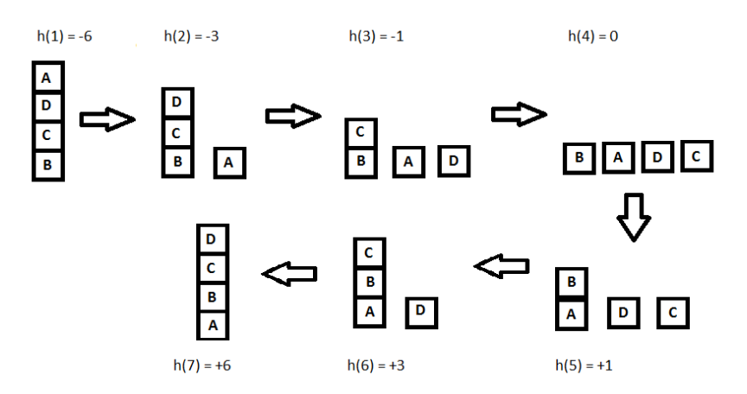

Slide 11
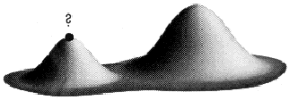
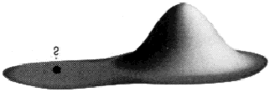
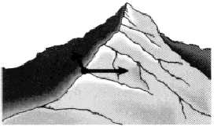
Limitations of Hill-climbing
Local Maxima: a local maximum as opposed to global maximum.
Way Out: Backtrack to some earlier node and try going in a different direction
2. Plateaus: An area of the search space where evaluation function is flat, thus requiring random walk.
Way out: Make a big jump to try to get in a new section
3. Ridge: Where there are steep slopes and the search direction is not towards the top but towards the side.
Way out: Moving in several directions at once.

Slide 12
Steepest-Ascent Hill Climbing
This is a variation of simple hill climbing which considers all the moves from the current state and selects the best one as the next state. Also known as Gradient search
Algorithm: Steepest-Ascent Hill Climbing
1.Evaluate the initial state. If it is also a goal state, then return it and quit. Otherwise, continue with the initial state as the current state.
2. Loop until a solution is found or until a complete iteration produces no change to current state:
Let SUCC be a state such that any possible successor of the current state will be better than SUCC
For each operator that applies to the current state do:
Apply the operator and generate a new state
Evaluate the new state. If is is a goal state, then return it and quit. If not, compare it to SUCC. If it is better, then set SUCC to this state. If it is not better, leave SUCC alone.
If the SUCC is better than the current state, then set current state to SUCC,

Slide 13
Simulated Annealing
Simulated Annealing (SA) is an effective and general form of optimization.
It is useful in finding global optima in the presence of large numbers of local optima. “Annealing” refers to an analogy with thermodynamics, specifically with the way that metals cool and anneal.
Simulated annealing uses the objective function of an optimization problem instead of the energy of a material. Implementation of SA is surprisingly simple. The algorithm is basically hill-climbing except instead of picking the best move, it picks a random move. If the selected move improves the solution, then it is always accepted. Otherwise, the algorithm makes the move anyway with some probability less than 1. The probability decreases exponentially with the “badness” of the move, which is the amount deltaE by which the solution is worsened (i.e., energy is increased.)

Slide 14
Local Beam Search
In this algorithm, it holds k number of states at any given time. At the start, these states are generated randomly. The successors of these k states are computed with the help of objective function. If any of these successors is the maximum value of the objective function, then the algorithm stops.
Otherwise the (initial k states and k number of successors of the states = 2k) states are placed in a pool. The pool is then sorted numerically. The highest k states are selected as new initial states. This process continues until a maximum value is reached.
function BeamSearch( problem, k), returns a solution stat
start with k randomly generated states
loop
generate all successors of all k states
if any of the states = solution, then return the state
else select the k best successors
end

Slide 15
SELF-ASSESSMENT QUESTIONS
Which of the following are the main disadvantages of a hill-climbing search?.
Stops at local optimum and don’t find the optimum solution
Stops at global optimum and don’t find the optimum solution
Fail to find a solution
None of these
Though local search algorithms are not systematic, key advantages would include __________
Less Memory
More time
Finds a solution in large infinite space
Less memory & Finds a solution in large infinite space

Slide 16
TERMINAL QUESTIONS
1. Demonstrate the Hill Climbing Algorithm with an example.
2. List out the limitations of Hill Climbing.
3. Describe the Local Beam Search algorithm.

Slide 17
REFERENCES FOR FURTHER LEARNING OF THE SESSION
Reference Books:
1. Patrick Henry Winston, ‘Artificial Intelligence’, Pearson Education (2003)
2. G. Luger, W. A. Stubblefield, "Artificial Intelligence", Third Edition, Addison-Wesley,(2007)
3. William F. Clocksin, Christopher S. Mellish-Programming in Prolog-Springer (2003)
4. Introducing Data science by Davy cielen, Arno D.B.Meysmen, Mohamed Ali
Sites and Web links:
1. https://www.youtube.com/watch?v=K9gH7hBAdpo (by IIT Delhi)
2. https://www.youtube.com/watch?v=GHpchgLoDvI&list=PLp6ek2hDcoNB_YJCruBFjhF79f5ZHyBuz
3. https://www.ics.uci.edu/~dechter/courses/ics-271/fall-12/

Slide 18
THANK YOU
Team – AI for Data Science

